Slide 1
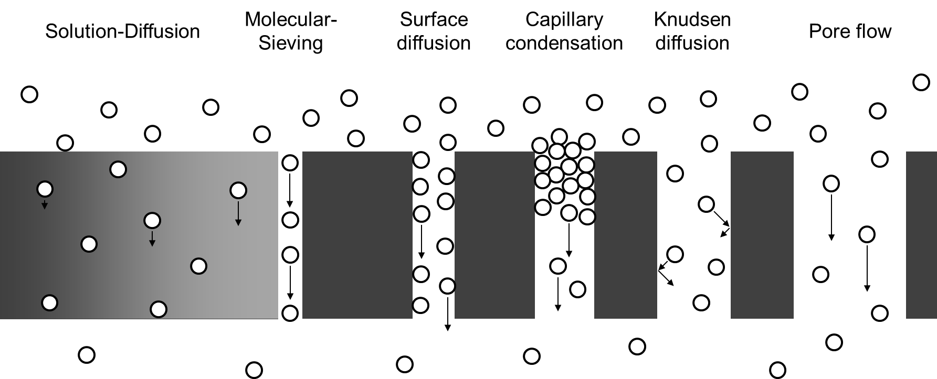
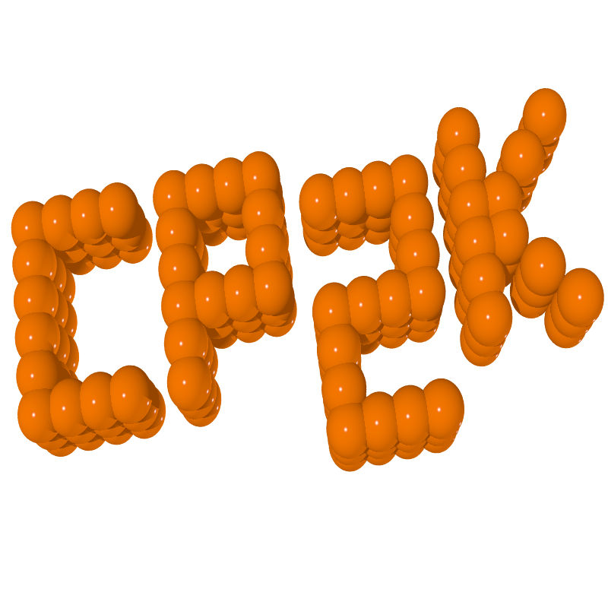
DyNAMICS OF CONDENSED MATTER
Impact of Hydrophobicity
On structure and dynamics
Inside nanopores

Slide 2
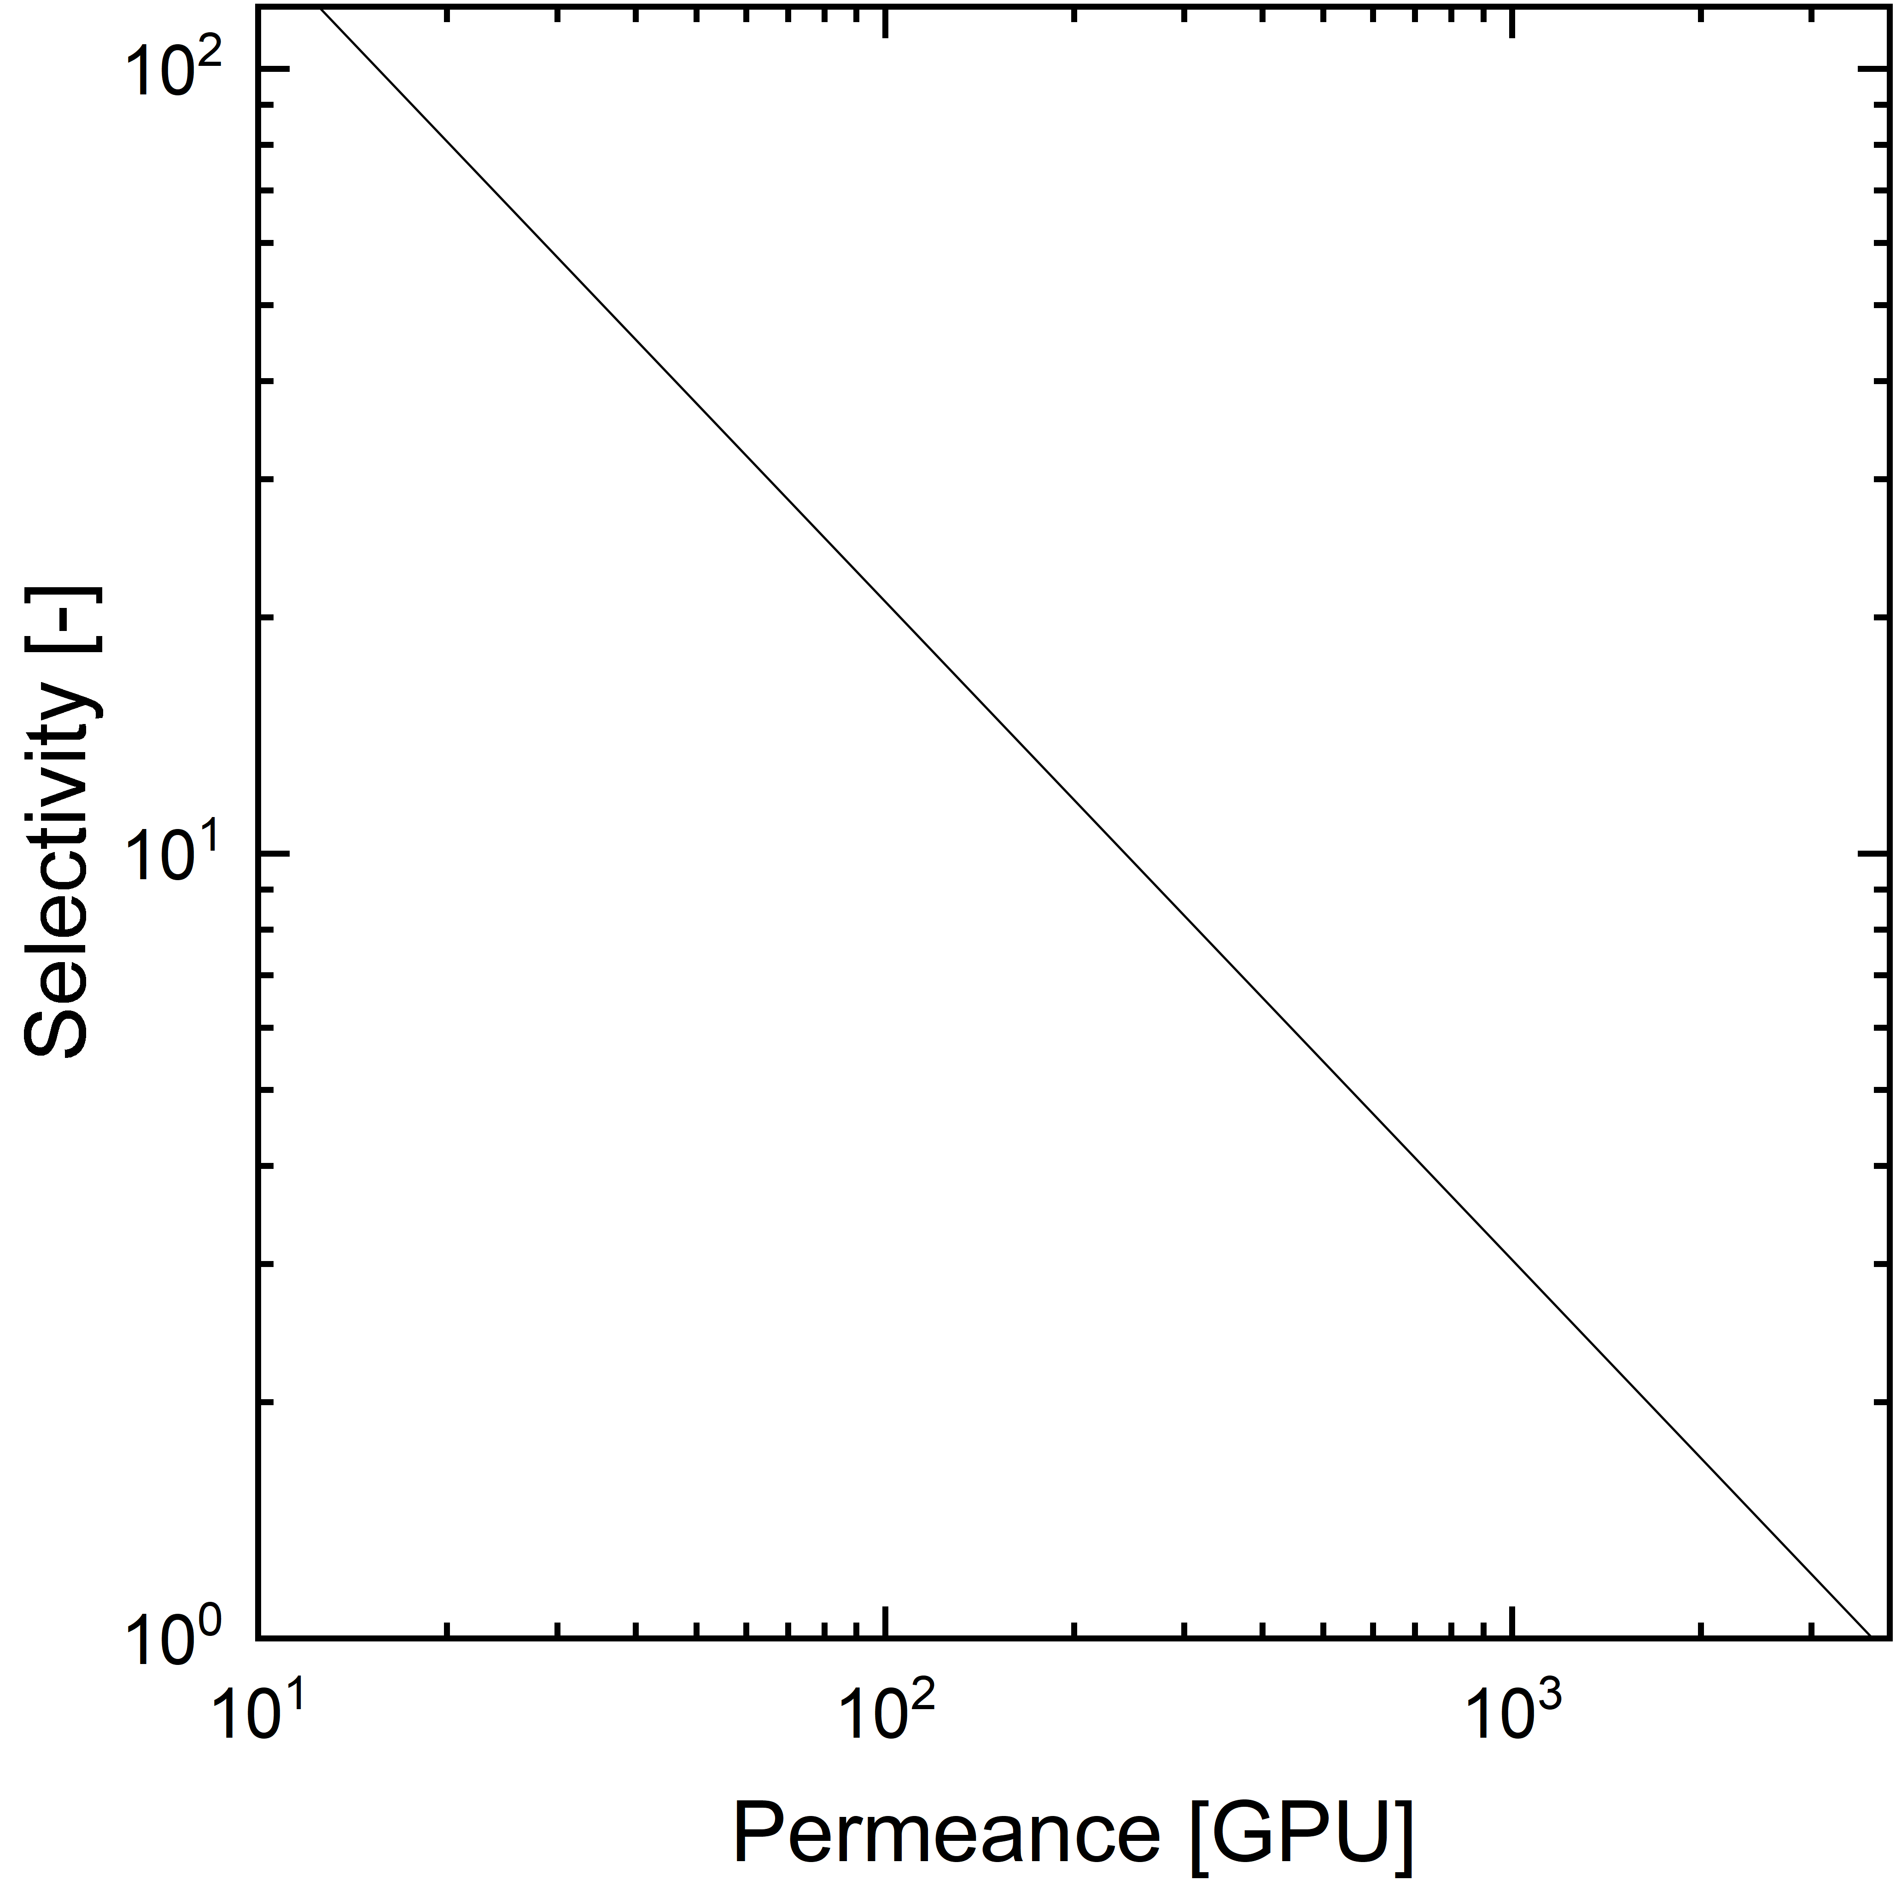
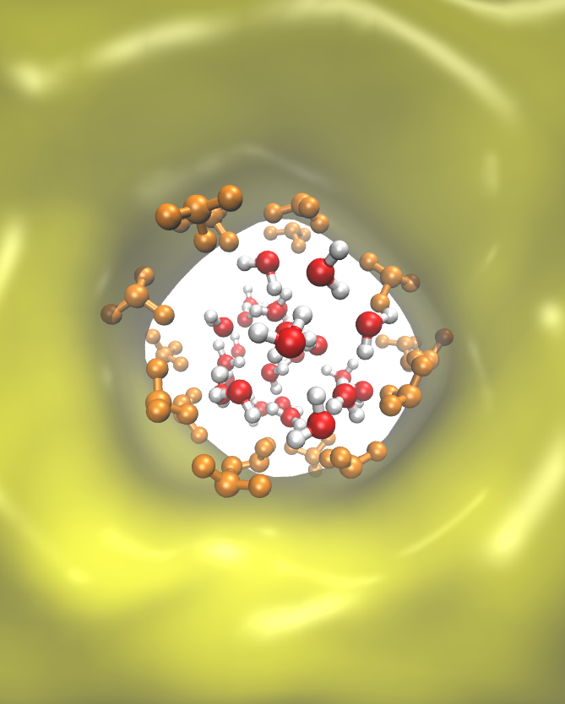
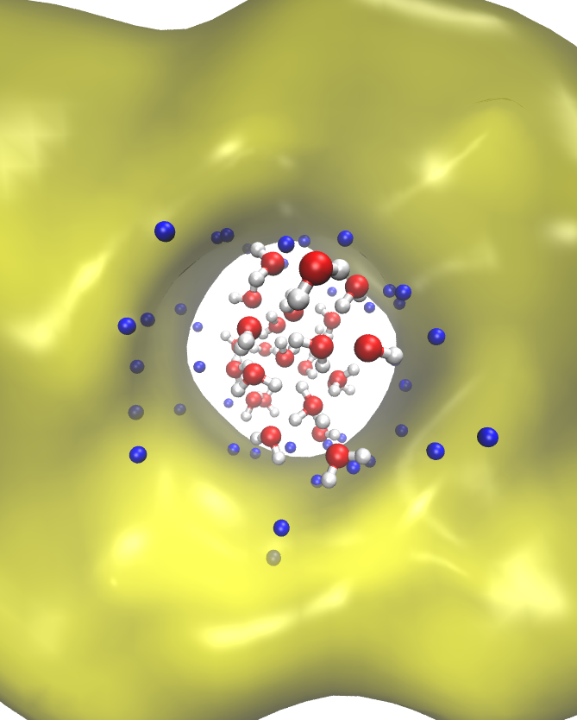
Engineer the membranes of the future
Permeability and selectivity

Slide 3
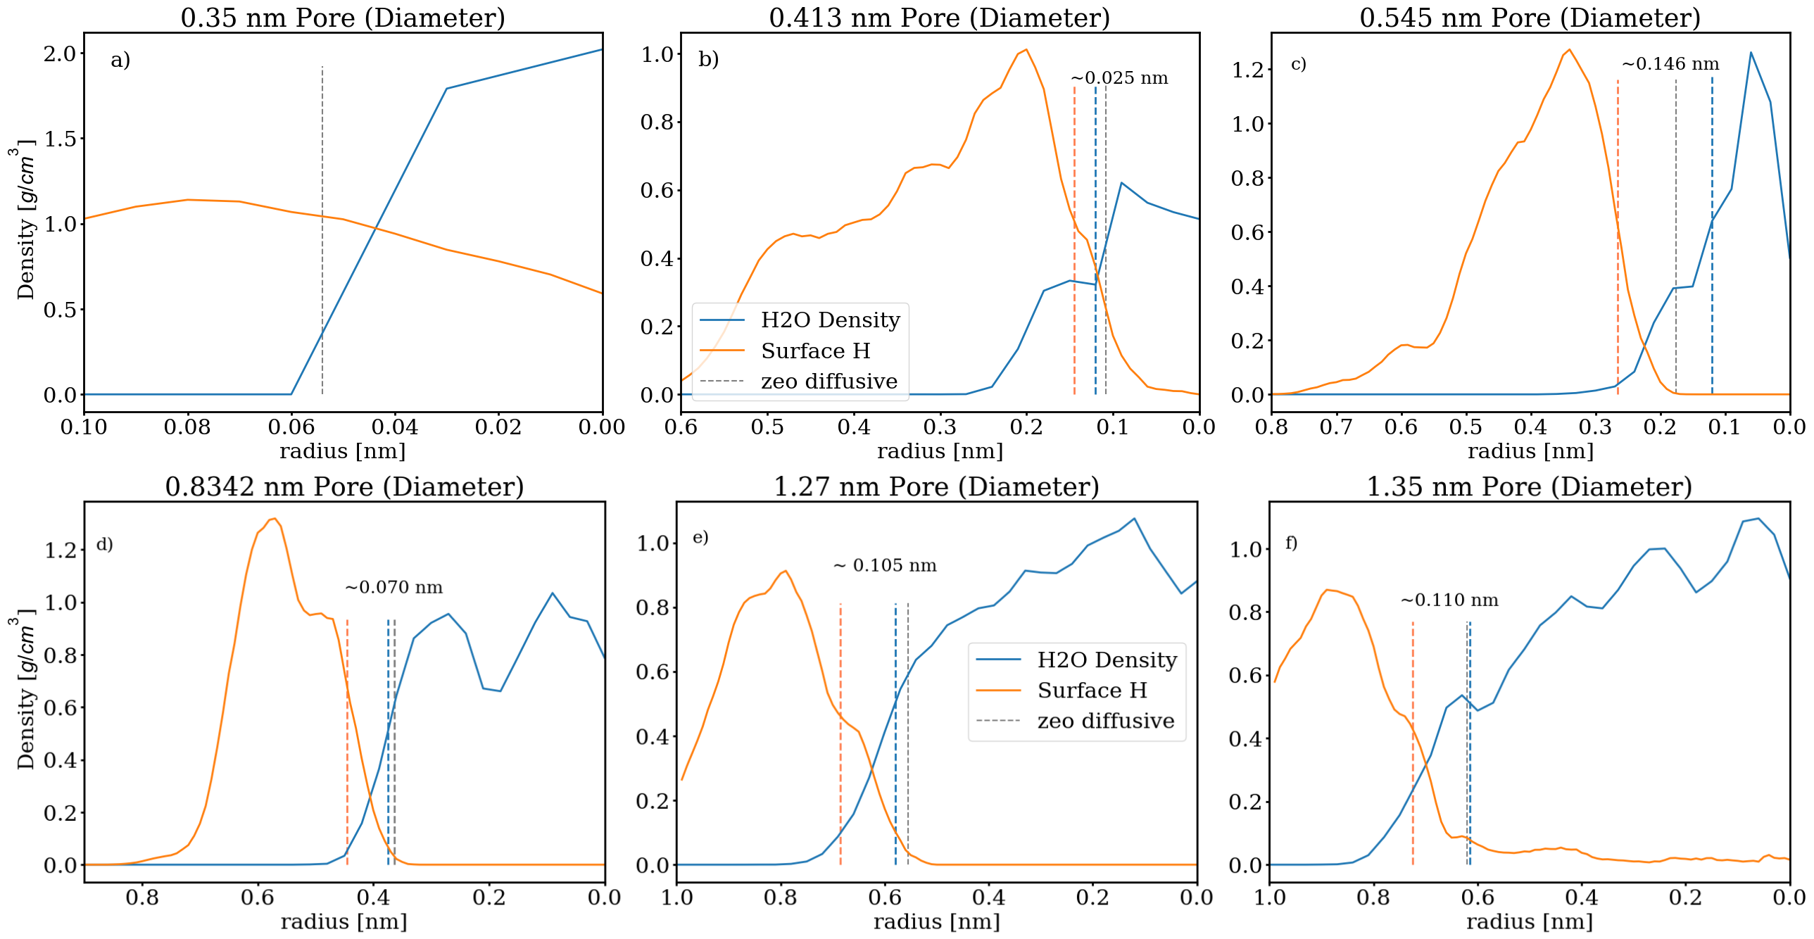
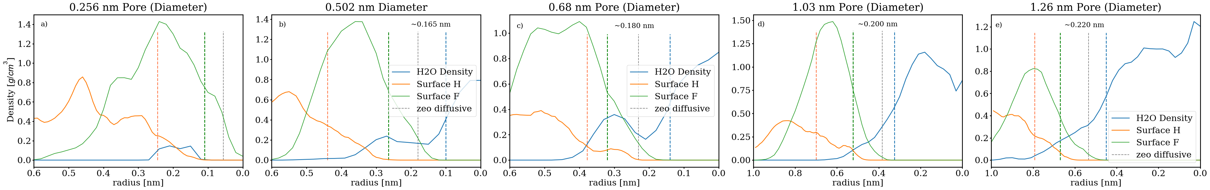
Structure of water inside nanopores
The issue of defining the surface

Slide 4
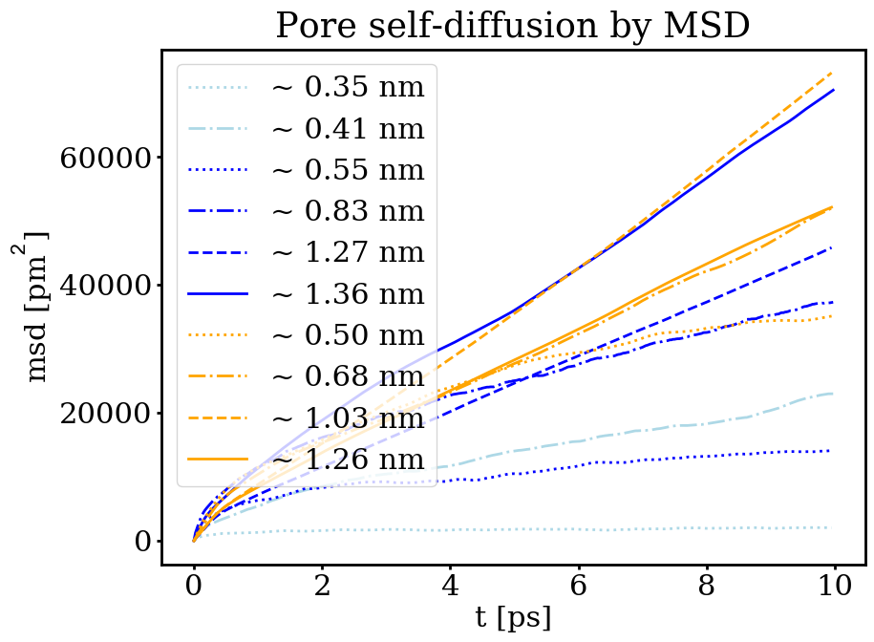
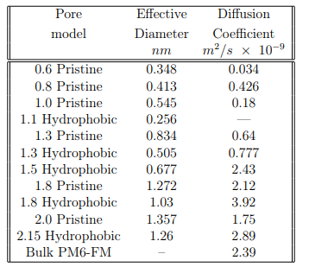
Self diffusion in nanopores
Hydrophobic super-diffusion?

Slide 5


Diffusion is faster in hydrophobic pores
But why?
1.3 nm
0.4 nm

Slide 6
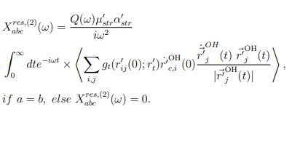
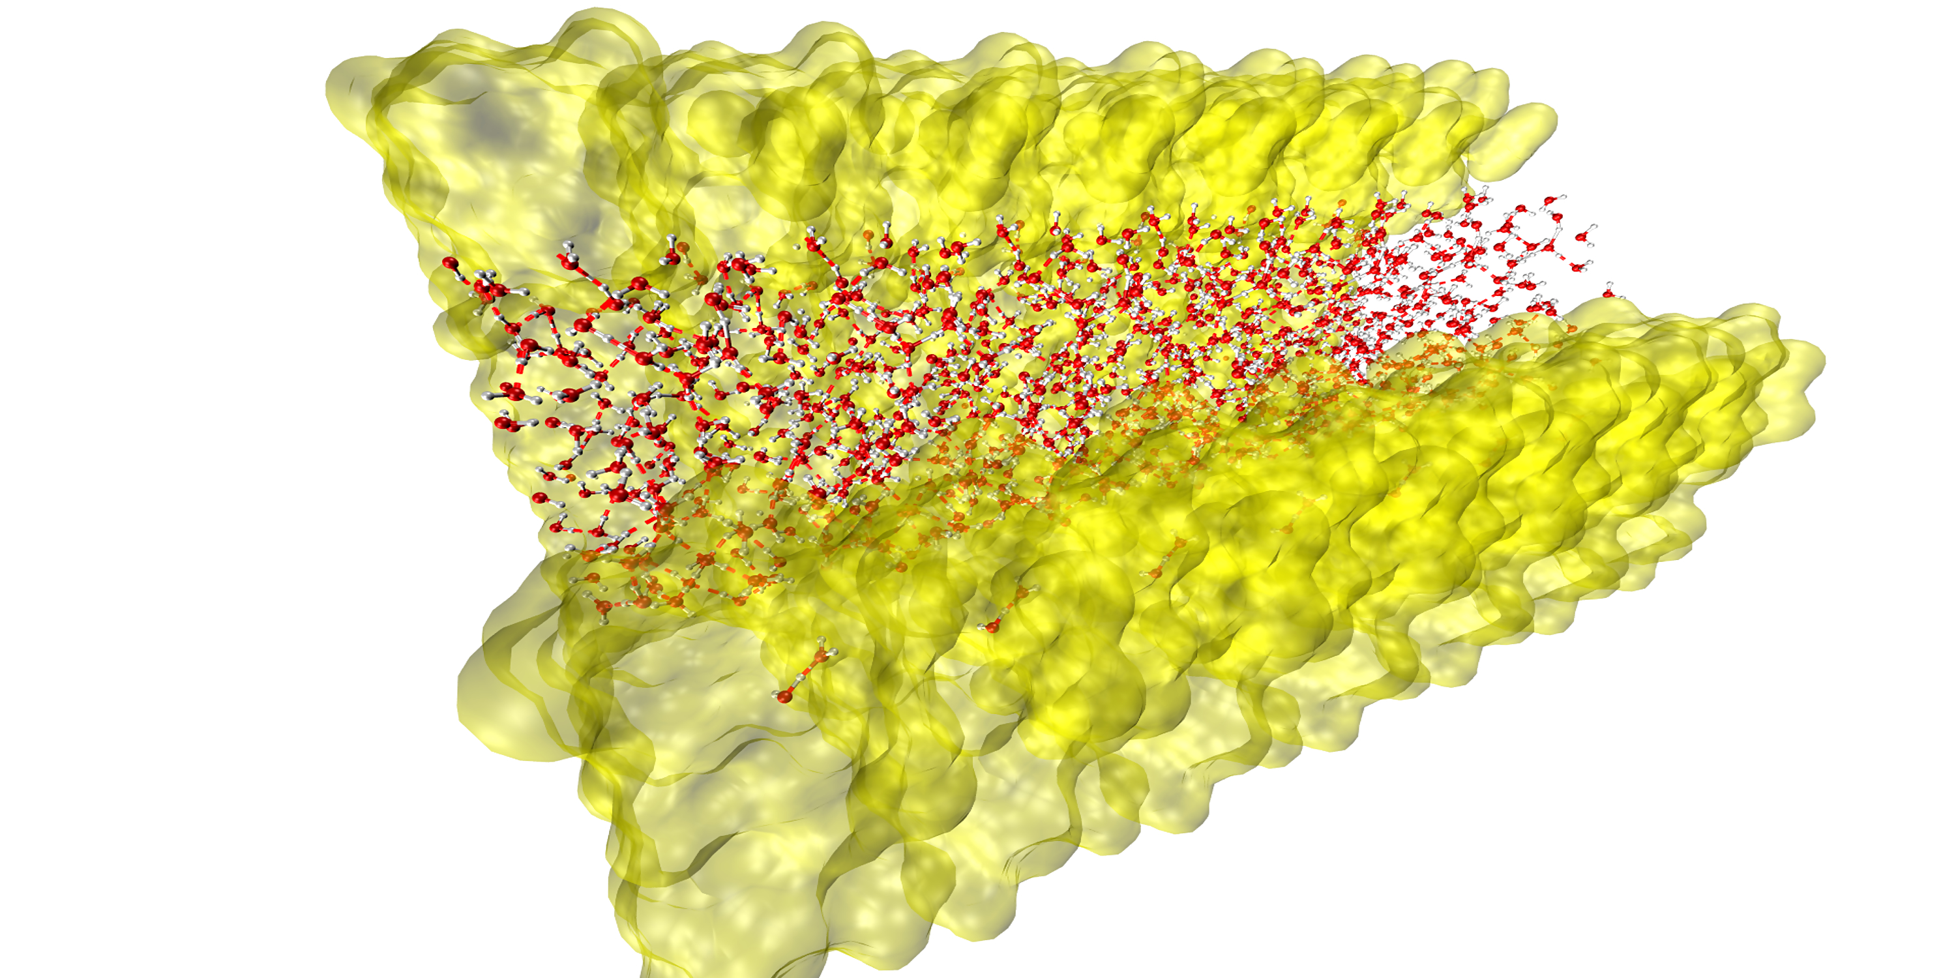
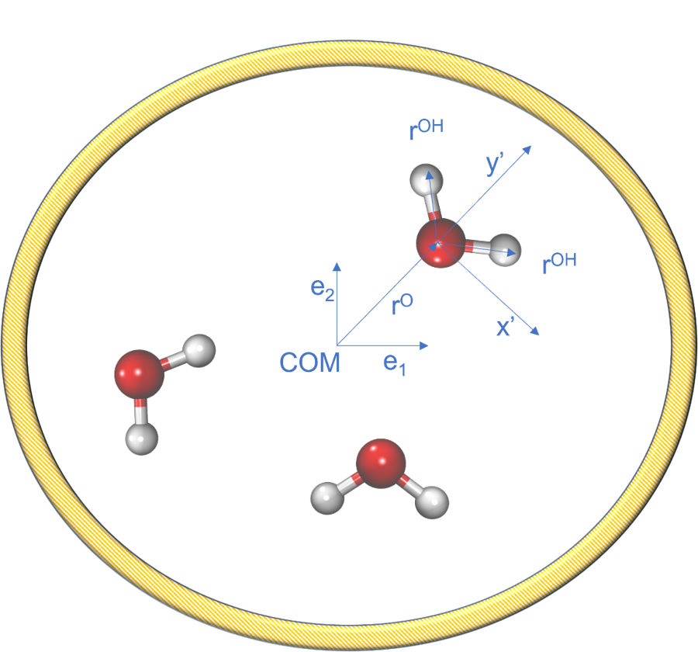
How to understand nanopores?
Computational methods
SFG
IR
Vis

Slide 7
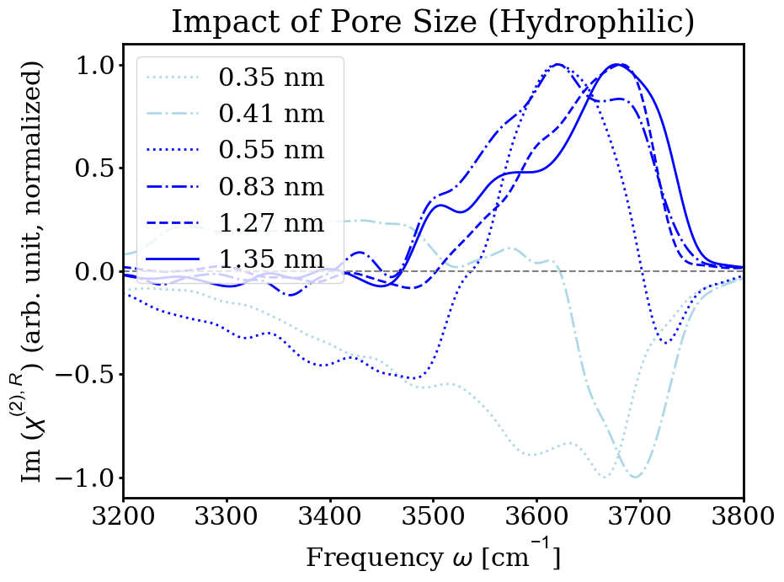
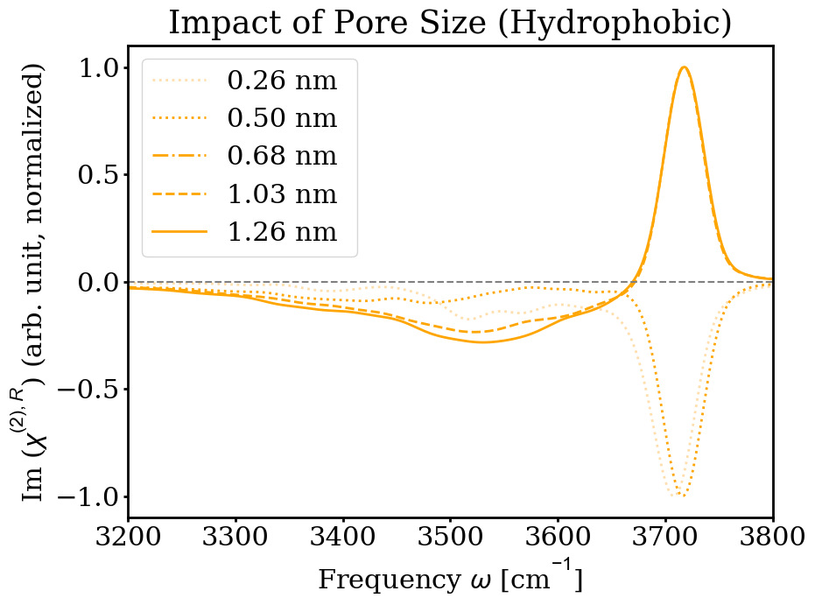
SFG Spectra
Impact of pore size and hydrophobicity

Slide 8
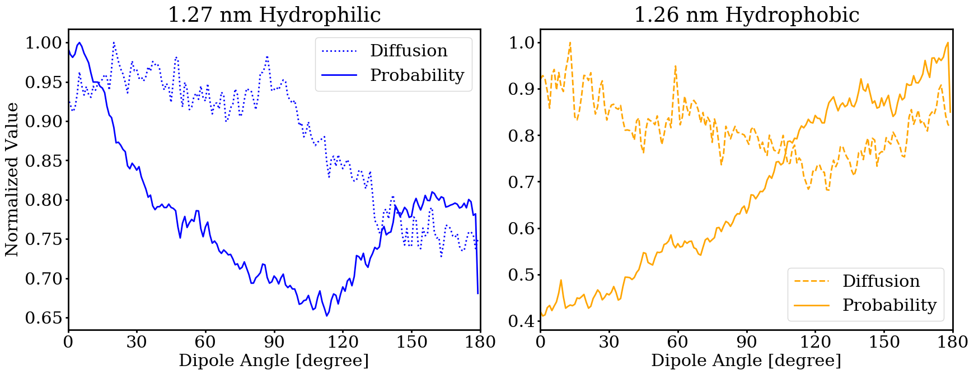
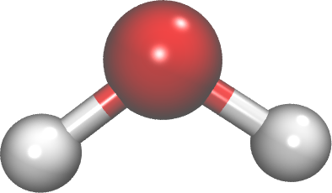
Angular Distribution vs diffusion
More new questions?

Slide 9
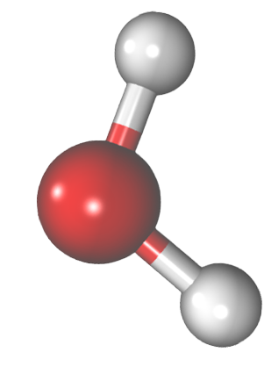
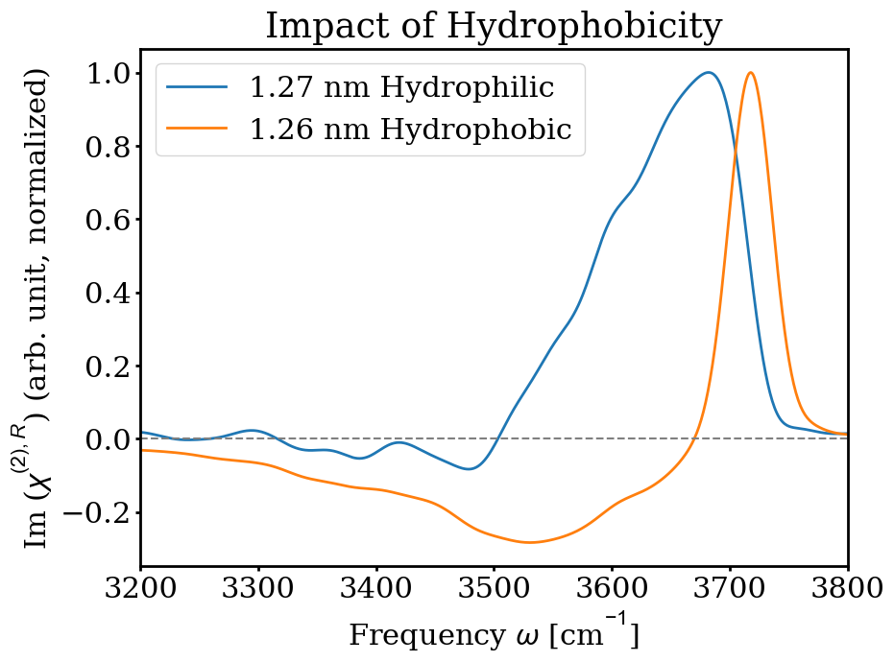
Species of water analyzed by sfg spectra
Interesting!
Hydrophobic
Hydrophilic
a)
d)
b)
e)
f)
c)
stronger bonding
Weaker bonding

Slide 10
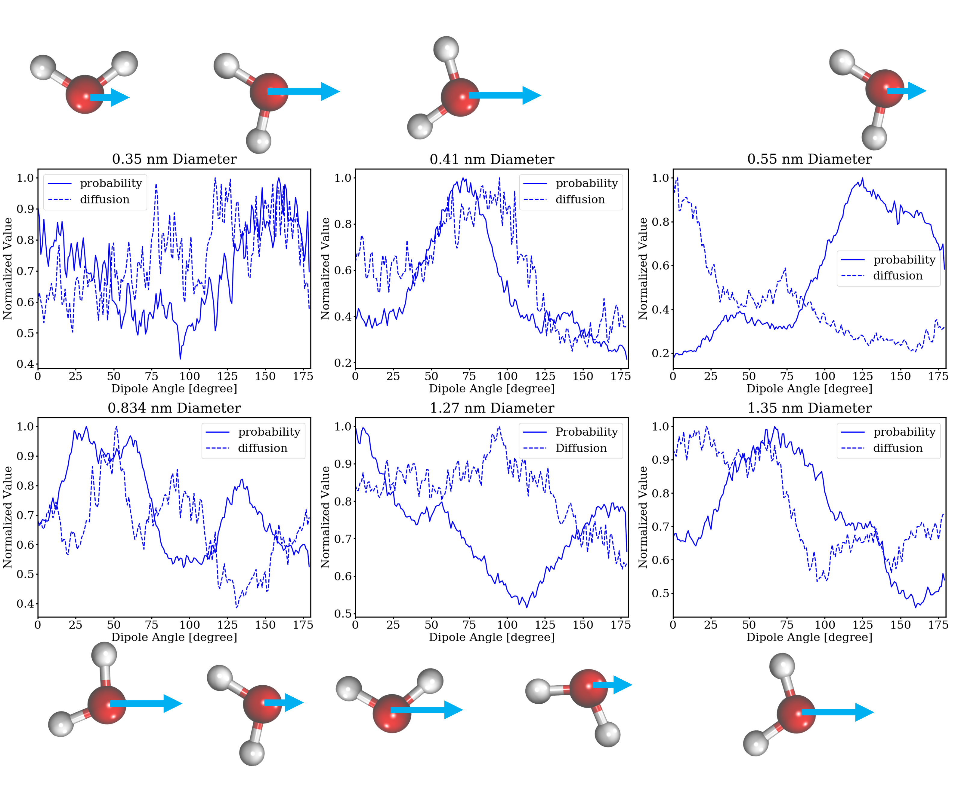
0°
0°

Slide 11
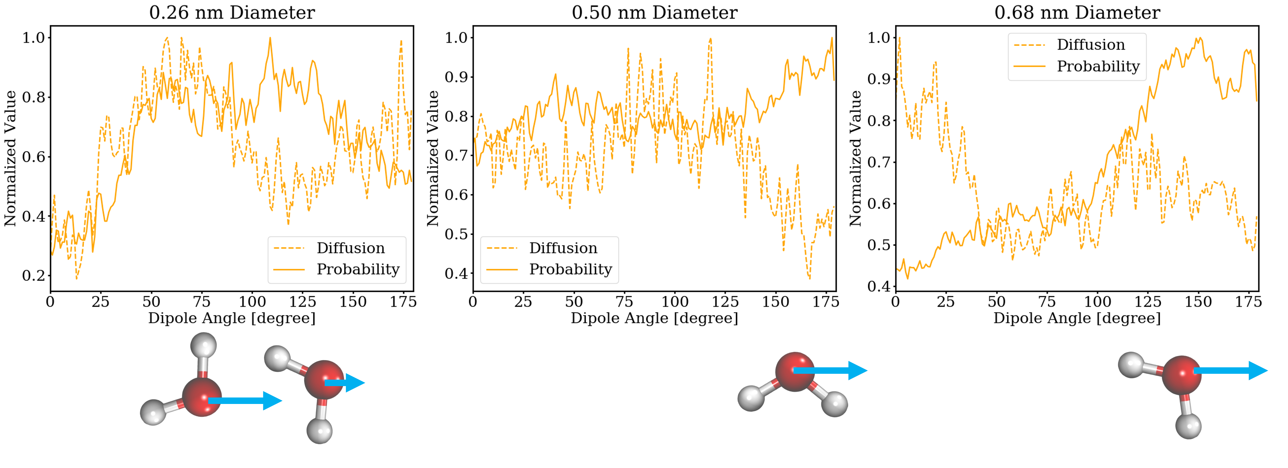
0°

Slide 12
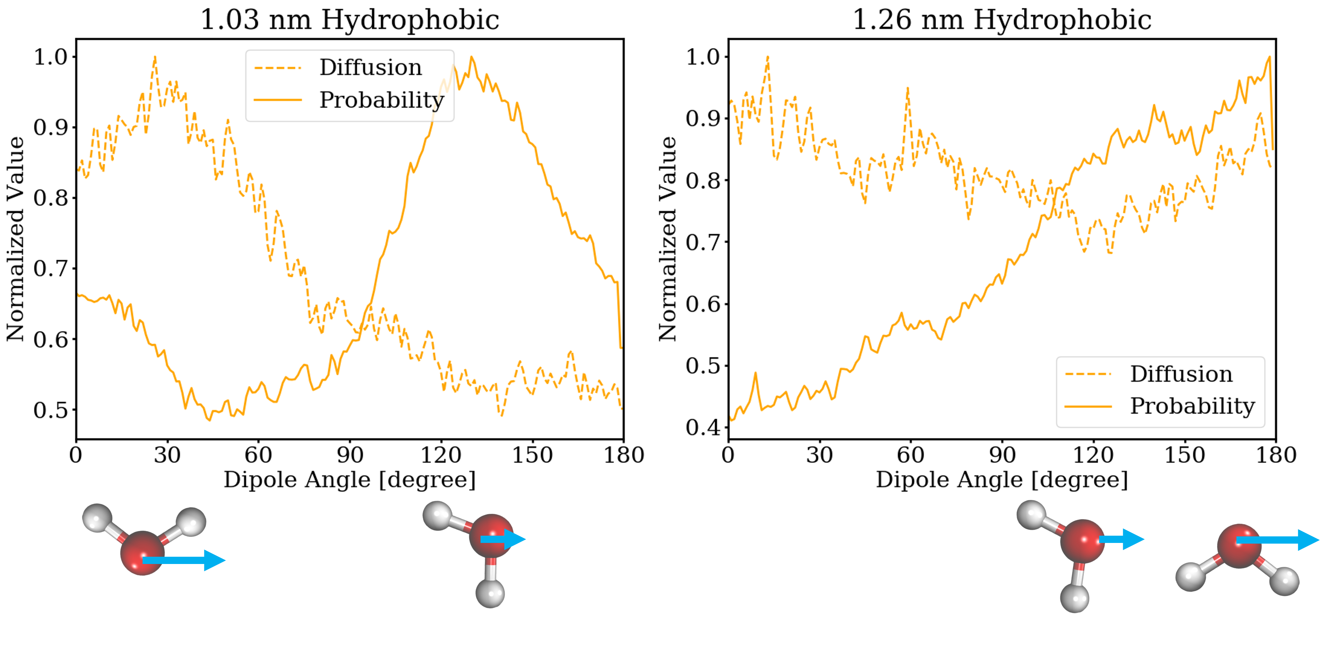
0°

Slide 13
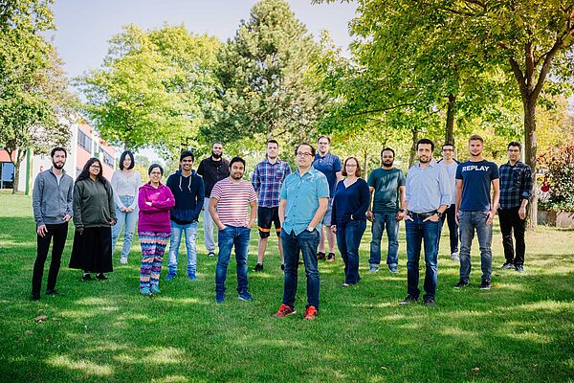

What to remember?
Thanks for the attention
1.3 nm
F
H
C
O
0.2 nm

